Slide 1
Database Types of Tables, Indexes
Kiryl Bucha
U1M3.Database Types of Tables, Indexes

Slide 2
Overview
The Origin and History Tables
Overview: Types of Tables (Heap organized tables, Index Organized tables etc.)
The Origin and History Indexes
Overview: Types of Indexes (B*Tree indexes, B*Tree cluster indexes etc.)

Slide 3
Tables

Slide 4
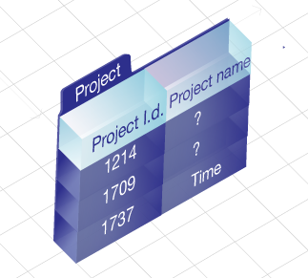
The Origin and History Tables
A table can have up to 1,000 columns.
A table can have a virtually unlimited number of rows.
(but typically a tablespace can have at most 1,022 files (although there are BIGFILE tablespaces in Oracle 10g that will get you beyond these file size limits, too). Say you have a typical tablespace and are using files that are 32GB in size—that is to say, 32,704GB)
A table can have as many indexes as there are permutations of columns
There is no limit to the number of tables you may have.

Slide 5
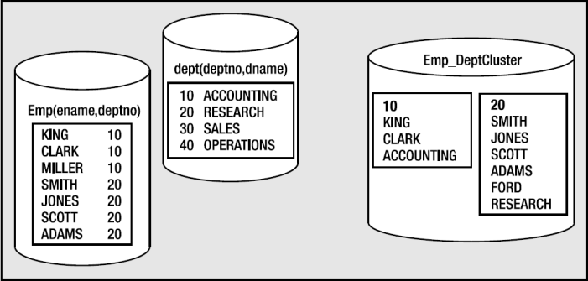
Types of a Tables
Heap organized tables: These are normal, standard database tables. Data is managed in a heap-like fashion. As data is added, the first free space found in the segment that can fit the data will be used.
Index organized tables: These tables are stored in an index structure. This imposes physical order on the rows themselves.
Index clustered tables: Clusters are groups of one or more tables, physically stored on the same database blocks, with all rows that share a common cluster key value being stored physically near each other.
Hash clustered tables: These tables are similar to index clustered tables, but instead of using a B*Tree index to locate the data, them locate data by hash cluster key.
Sorted hash clustered tables: This table type is new in Oracle 10g and combines some aspects of a hash-clustered table with those of an IOT.

Slide 6

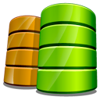
Types of a Tables
Nested tables: These are part of the object-relational extensions to Oracle. They are simply system-generated and maintained child tables in a parent/child relationship.
Temporary tables: These tables store scratch data for the life of a transaction or the life of a session. These tables allocate temporary extents, as needed, from the current user’s temporary tablespace.
Object tables: These tables are created based on an object type. They have special attributes not associated with non-object tables, such as a system-generated REF (object identifier) for each row.
External tables: The data in these tables are not stored in the database itself; rather, they reside outside of the database in ordinary operating system files.

Slide 7
Indexes

Slide 8
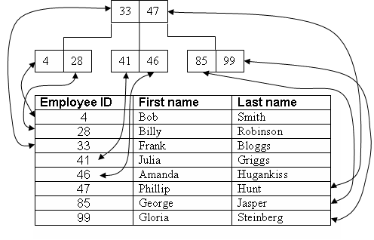
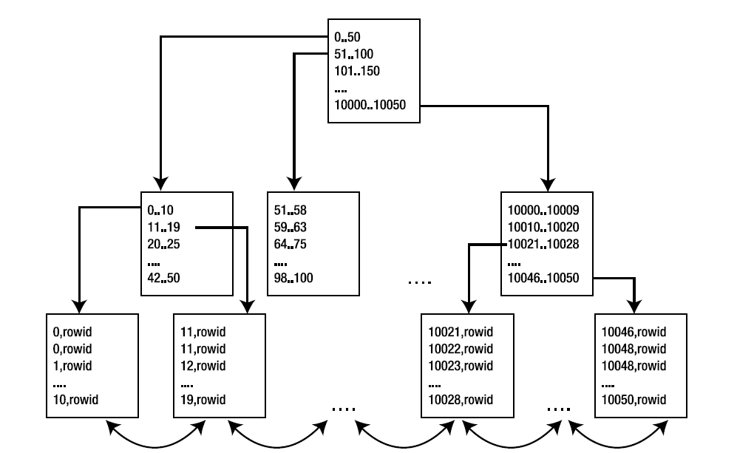
The Origin and History Indexes
B*Tree indexes: They are, by far, the most common indexes in use in Oracle and most other databases. Similar in construct to a binary tree, B*Tree indexes provide fast access, by key, to an individual row or range of rows, normally requiring few reads to find the correct row.

Slide 9
Types of B*Tree indexes
Index organized tables: These are tables stored in a B*Tree structure.
B*Tree cluster indexes: These are a slight variation of conventional B*Tree indexes. They are used to index the cluster keys
Reverse key indexes: These are B*Tree indexes whereby the bytes in the key are reversed. Reverse key indexes can be used to obtain a more even distribution of index entries throughout an index that is populated with increasing values.
Function-based indexes: These are B*Tree or bitmap indexes that store the computed result of a function on a row’s column(s), not the column data itself.

Slide 10
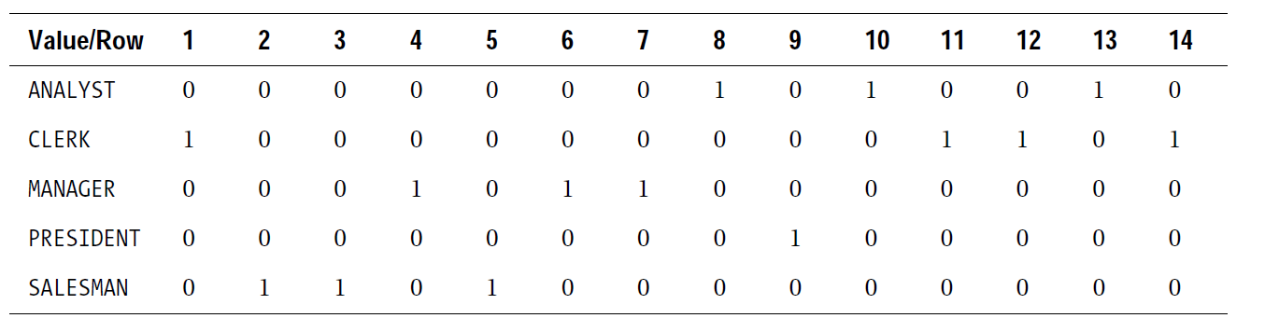
Bitmap indexes
Bitmap indexes are structures that store pointers to many rows with a single index key entry, as compared to a B*Tree structure where there is parity between the index keys and the rows in a table. In a bitmap index, there will be a very small number of index entries, each of which points to many rows.

Slide 11
Thank you Time for questions
Kiryl Bucha
U1M3.Database Types of Tables, Indexes

